Slide 1


Slide 2
Recap:
Machine Learning
Concepts

Slide 3
Target

Slide 4
Tree-based Method

Slide 5
Supervised

Slide 6
Feature

Slide 7
Underfitting

Slide 8
Parsimony

Slide 9
Feature Engineering

Slide 10
(notebook and dataset)
Download the two datasets:
Customer_flights
Customer_table
Notebook we’ll follow (written in R):
Feature Engineering

Slide 11
Model Interpretation

Slide 12
Distance Metrics

Slide 13
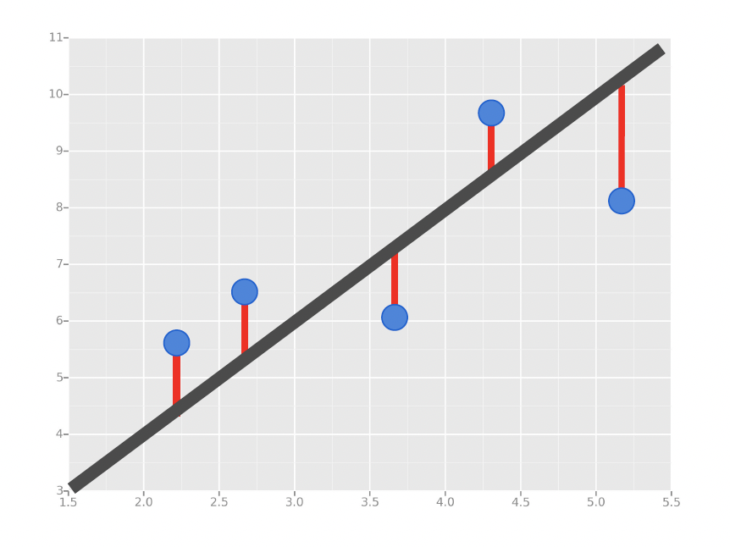
Distance Metrics
In Supervised Learning, we’re concerned with minimizing the distance between our model (e.g. line, curve, etc.) and the gathered data.

Slide 14
Error Metrics
Distance Metrics
In Supervised Learning, we’re concerned with minimizing the distance between our model (e.g. line, curve, etc.) and the gathered data.
For problems with continuous targets (i.e. Regression), there are three common ways we measure distance:
Mean Absolute Error (MAE)
Mean Squared Error (MSE)
Root Mean Squared Error (RMSE)

Slide 15

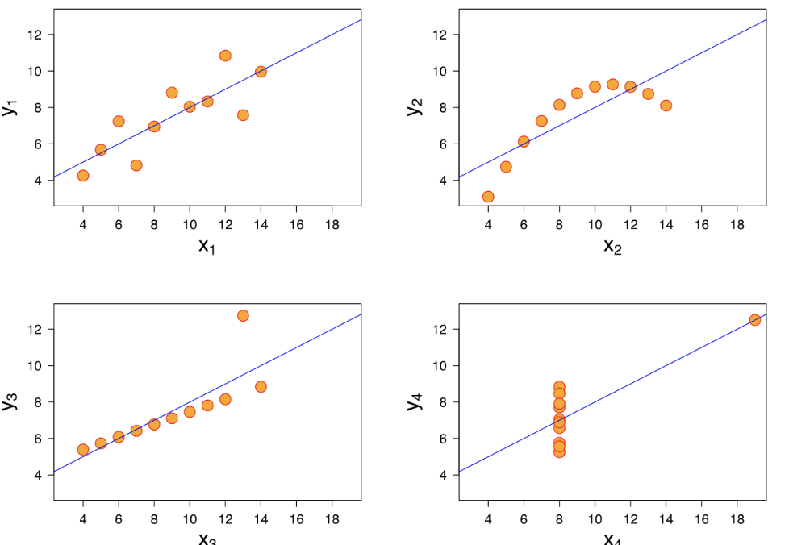
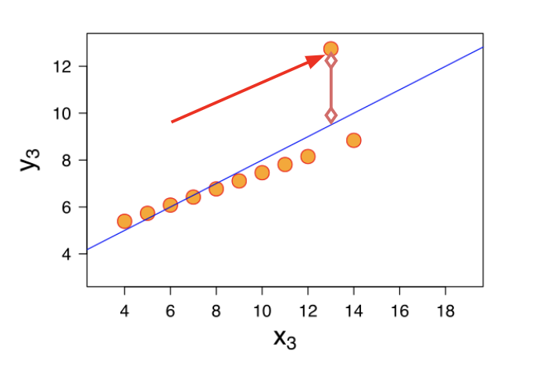
Error Metrics
Distance Metrics
Mean Absolute Error (MAE)
This is the mean of the absolute value of errors.
Easy to understand
MAE won’t punish large errors
We want our error metrics to account for these!
Notes:
Let’s take a moment now to discuss evaluating Regression Models
Regression is a task when a model attempts to predict continuous values (unlike categorical values, which is classification)
You may have heard of some evaluation metrics like accuracy or recall.
These sort of metrics aren’t useful for regression problems, we need metrics designed for continuous values!
Can you give me continuous versus categorical variables?

Slide 16
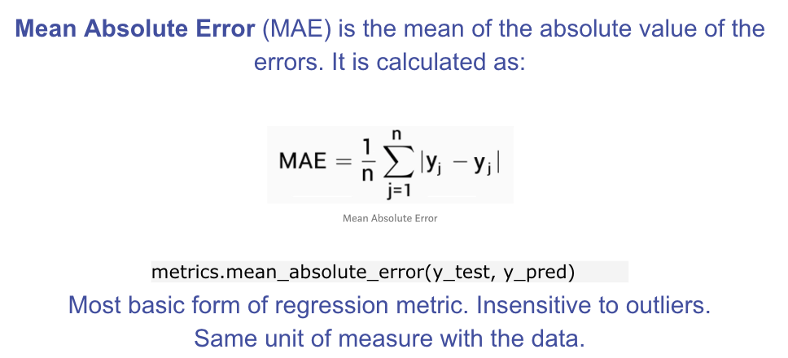
Error Metrics
Distance Metrics

Slide 17
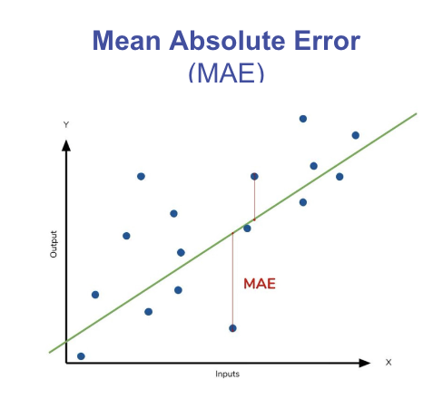
Error Metrics
Distance Metrics

Slide 18
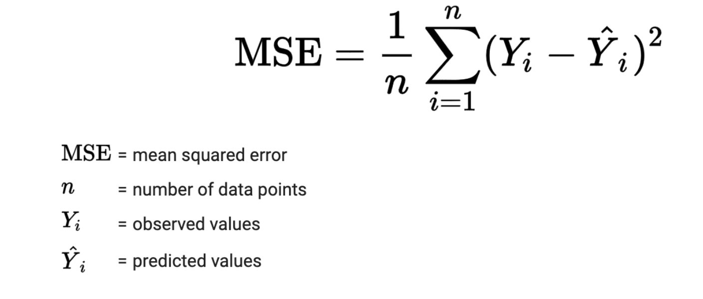
Error Metrics
Distance Metrics
Mean Squared Error (MSE)
This is the mean of the squared errors.
Larger errors are noted more than with MAE, making MSE more popular.
Notes:
Let’s take a moment now to discuss evaluating Regression Models
Regression is a task when a model attempts to predict continuous values (unlike categorical values, which is classification)
You may have heard of some evaluation metrics like accuracy or recall.
These sort of metrics aren’t useful for regression problems, we need metrics designed for continuous values!

Slide 19
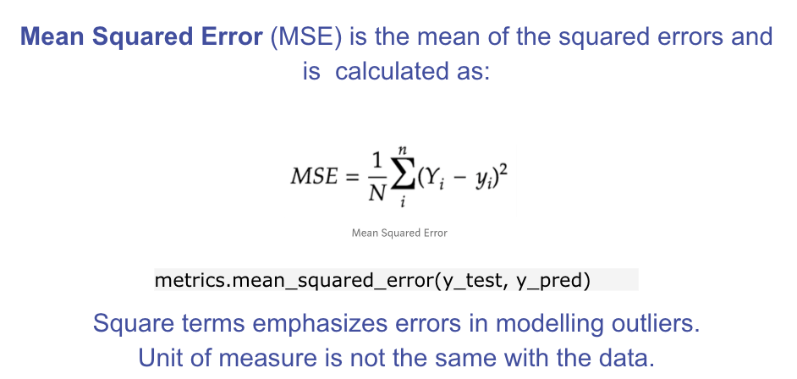
Error Metrics
Distance Metrics
These formulas can be coded up to determine an iterative way to print out the MSE.
Notes:
Let’s analyze what this equation actually means.
In mathematics, the character that looks like weird E is called summation (Greek sigma). It is the sum of a sequence of numbers, from i=1 to n. Let’s imagine this like an array of points, where we go through all the points, from the first (i=1) to the last (i=n).
For each point, we take the y-coordinate of the point, and the y’-coordinate. The y-coordinate is our purple dot. The y’ point sits on the line we created. We subtract the y-coordinate value from the y’-coordinate value, and calculate the square of the result.
The third part is to take the sum of all the (y-y’)² values, and divide it by n, which will give the mean.
Our goal is to minimize this mean, which will provide us with the best line that goes through all the points.

Slide 20
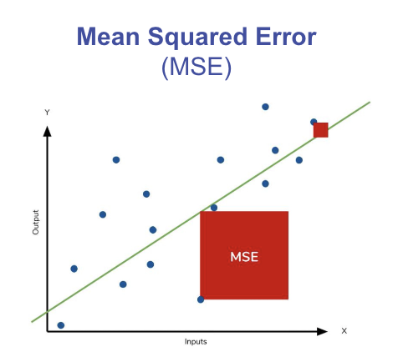
Error Metrics
Distance Metrics

Slide 21

Error Metrics
Distance Metrics
Root Mean Square Error (RMSE)
This is the root of the mean of the squared errors.
Most popular (has same units as y)
Common question: “Is this value of RMSE good?”
Context is everything!
A RMSE of $10 is fantastic for predicting the price of a house, but horrible for predicting the price of a candy bar!
Notes:
Compare your error metric to the average value of the label in your data set to try to get an intuition of its overall performance.
Domain knowledge also plays an important role here!
Context of importance is also necessary to consider.
We may create a model to predict how much medication to give, in which case small fluctuations in RMSE may actually be very significant.
Root Mean Square Error (RMSE) is the standard deviation of the residuals (prediction errors). Residuals are a measure of how far from the regression line data points are; RMSE is a measure of how spread out these residuals are. In other words, it tells you how concentrated the data is around the line of best fit. Root mean square error is commonly used in climatology, forecasting, and regression analysis to verify experimental results.

Slide 22
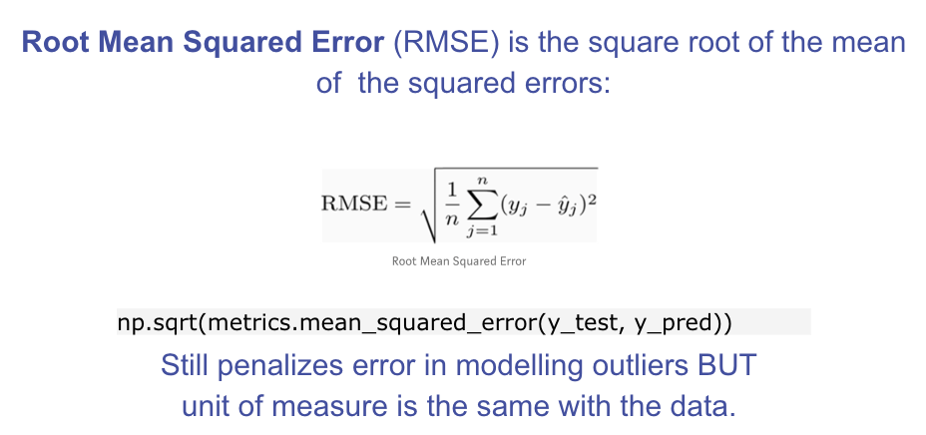
Error Metrics
Distance Metrics

Slide 23
Error Metrics
Distance Metrics
Spreadsheet Example

Slide 24
Error Metrics
Distance Metrics
In Supervised Learning, we’re concerned with minimizing the distance between our model (e.g. line, curve, etc.) and the gathered data.

Slide 25
Error Metrics
Distance Metrics
In Supervised Learning, we’re concerned with minimizing the distance between our model (e.g. line, curve, etc.) and the gathered data.
What are some surefire ways in which we can minimize our distance metrics?

Slide 26
Error Metrics
Distance Metrics
In Supervised Learning, we’re concerned with minimizing the distance between our model (e.g. line, curve, etc.) and the gathered data.
What are some surefire ways in which we can minimize our distance metrics?
Better Features
More Features

Slide 27
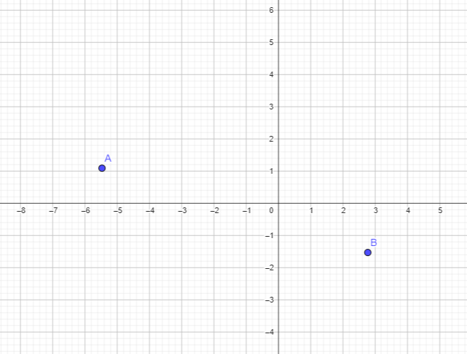
Error Metrics
Distance Metrics
Consider polynomial functions (for easy visualization):
Given 2 data points, what’s the smallest degree polynomial that will perfectly hit both points?

Slide 28
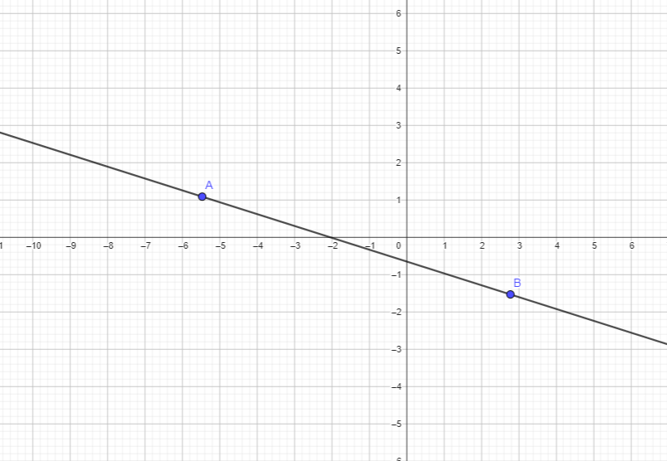
Error Metrics
Distance Metrics
Consider polynomial functions (for easy visualization):
Given 2 data points, what’s the smallest degree polynomial that will perfectly hit both points?
Smallest Degree = 1 (line): mx + b

Slide 29
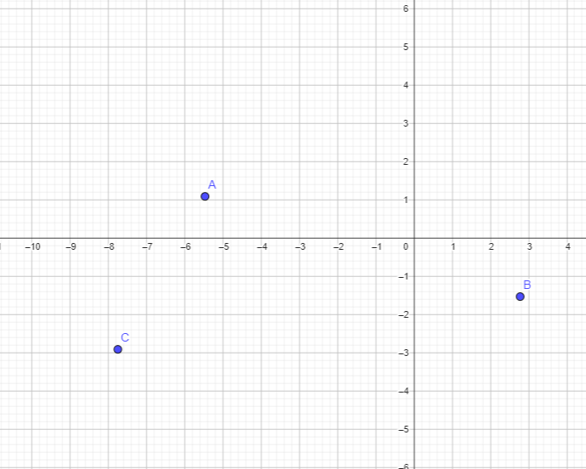
Error Metrics
Distance Metrics
Consider polynomial functions (for easy visualization):
Given 3 data points, what’s the smallest degree polynomial that will perfectly hit both points?

Slide 30
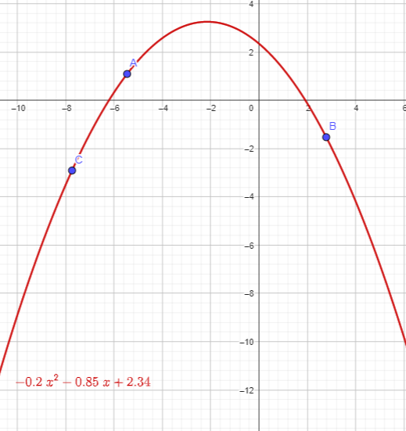

Error Metrics
Distance Metrics
Consider polynomial functions (for easy visualization):
Given 3 data points, what’s the smallest degree polynomial that will perfectly hit both points?
Degree = 2 (Quadratic form):

Slide 31
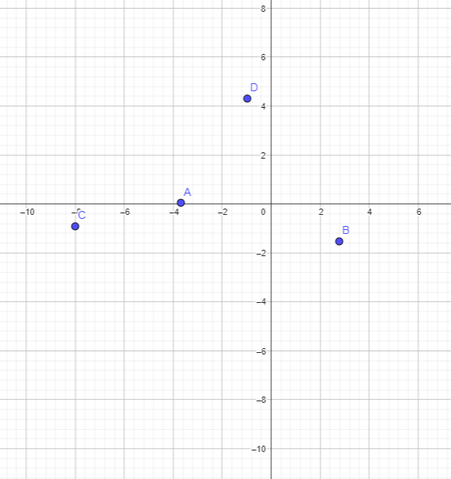
Error Metrics
Distance Metrics
Consider polynomial functions (for easy visualization):
Given 4 data points, what’s the smallest degree polynomial that will perfectly hit both points?

Slide 32
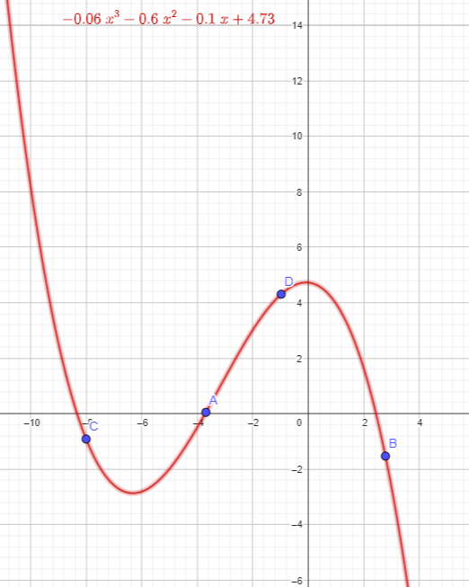
Error Metrics
Distance Metrics
Consider polynomial functions (for easy visualization):
Given 4 data points, what’s the smallest degree polynomial that will perfectly hit both points?
Degree = 3 (cubic form)

Slide 33
Error Metrics
Distance Metrics
In general, if we have n data points, we can find a “line” (or hyperplane) that hits all these points perfectly if we use n-1 variables/dimensions.

Slide 34
Error Metrics
Distance Metrics
In general, if we have n data points, we can find a “line” (or hyperplane) that hits all these points perfectly if we use n-1 variables/dimensions.
Is this something we want?

Slide 35
Error Metrics
Distance Metrics
How do we measure “goodness of fit”/”distance” when our outcome is binary (or more broadly, categorical)?

Slide 36
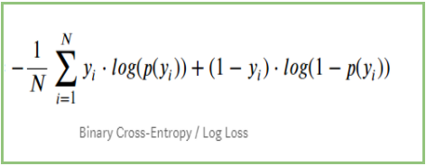
Error Metrics
Distance Metrics
How do we measure “goodness of fit”/”distance” when our outcome is binary (or more broadly, categorical)?
LogLoss (Cross-Entropy):
Used for binary classification problems (0, 1)
Measures the distance between actual values (0, 1) and the probabilities returned by the model (e.g. 0.5, 0.8, 0.9)

Slide 37
Error Metrics
Distance Metrics
LogLoss (Cross-Entropy):
Used for binary classification problems (0, 1)
Measures the distance between actual values (0, 1) and the probabilities returned by the model (e.g. 0.5, 0.8, 0.9)
Baseline Model: Uninformative Model (randomly guessing)

Slide 38
Error Metrics
Distance Metrics
For continuous cases (regression):
What would be a good baseline model?

Slide 39
Performance Metrics

Slide 40
Performance Metrics
Low enough error metrics, but not too low…
How do we evaluate these?

Slide 41
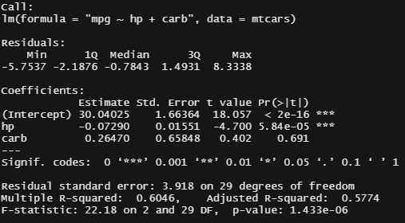
Performance Metrics

Slide 42
Performance Metrics
Residuals: distances between model and data points (y - y_est)
Degrees of freedom (DF): Sample Size - # of Variables (Typically)

Slide 43
Performance Metrics
Residual Standard Error:
Sqrt. of the Sum of Squared Residuals, divided by a denominator based on deg. of freedom s.t. denominator is higher as d.f. increases.

Slide 44
Performance Metrics
R-Squared: % of data’s variability the model is able to account for (~goodness of fit)
Basic/Multiple R-Squared: always approaches 1 as # of variables increases

Slide 45
Performance Metrics
Adjusted R-Square:
Same concept as Multiple R-Squared, but computed such that a penalty is applied for each additional variable included

Slide 46
Testing Metrics

Slide 47
Testing Metrics
Aside from fit metrics that penalize overfitting, we can also make use of methods that split our data into test/train sets (or cross-validations).

Slide 48
Testing Metrics
Aside from fit metrics that penalize overfitting, we can also make use of methods that split our data into test/train sets (or cross-validations).
For Continuous Cases:
We can still make use of RMSE, MAE, MSE to check how well the model is able to generalize.

Slide 49
Testing Metrics
Aside from fit metrics that penalize overfitting, we can also make use of methods that split our data into test/train sets (or cross-validations).
For Continuous Cases:
We can still make use of RMSE, MAE, MSE to check how well the model is able to generalize.
For Classification Cases:
LogLoss is still applicable; however, it’s not as easy to interpret as the distance metrics for continuous case.

Slide 50
Testing Metrics
Confusion Matrix Material

Slide 51
Testing Metrics
When you’re doing (binary) classification, one of the steps near the end is setting a threshold s.t. If y_est >= threshold, they’re predicted to be a case (otherwise they’re predicted to be a control.
Are our classification metrics (TPR, FPR, etc) affected by the setting of the threshold?

Slide 52
Testing Metrics
When you’re doing (binary) classification, one of the steps near the end is setting a threshold s.t. If y_est >= threshold, they’re predicted to be a case (otherwise they’re predicted to be a control.
Think of examples where we might want to emphasize one specific metric over another (e.g. Cases where TPR is much more important, even if we have to sacrifice other metrics to raise it).

Slide 53
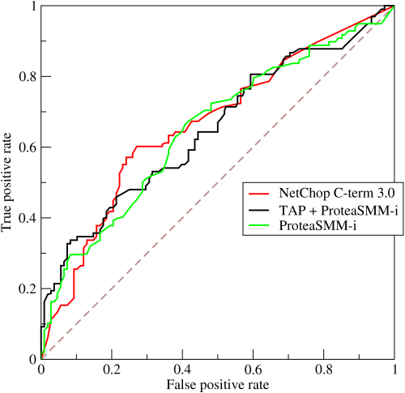
Testing Metrics
The ROC Curve (Receiving Operator Characteristics Curve) plots TPR (sensitivity) and FPR (fallout, 1-specificity) at different threshold values.
The diagonal line is the ROC of the uninformative classifier.

Slide 54
Testing Metrics
AUC: Area under a specific ROC curve.
If AUC <= 0.5, classifier is worse or just as good as uninformative classifier.
Higher AUC -> generally better classifier

Slide 55
Testing Metrics
TPR = TP / P
1 - Specificity = 1 - TN/N

Slide 56
Testing Metrics
TPR = TP / P
1 - Specificity = 1 - TN/N
What happens when the dataset has low prevalence?

Slide 57
Testing Metrics
TPR = TP / P
1 - Specificity = 1 - TN/N
What happens when the dataset has low prevalence?

Slide 58
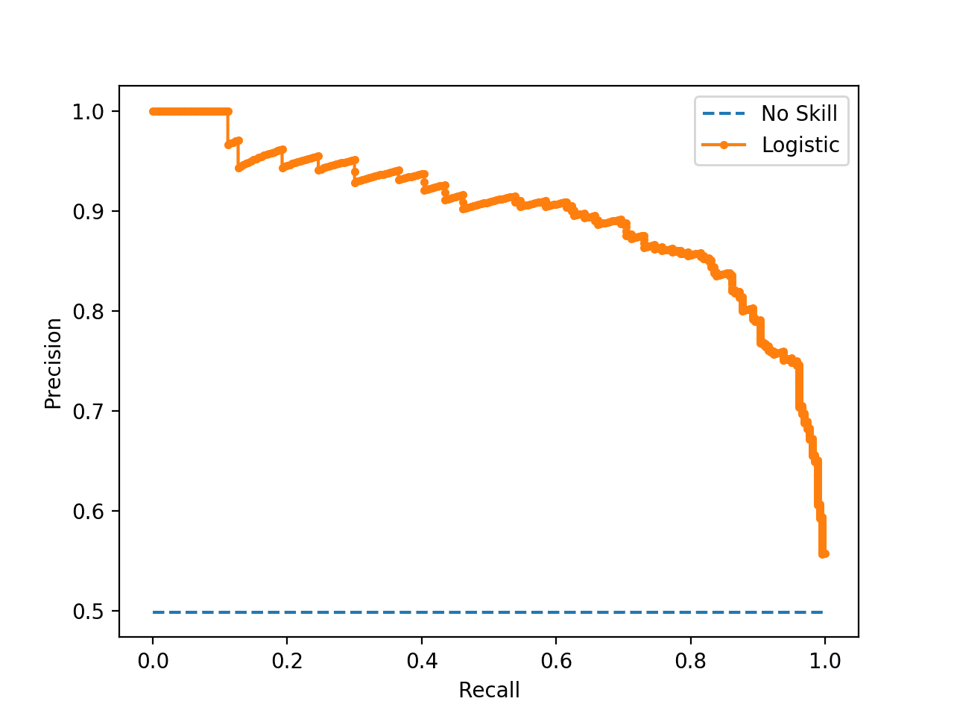
Testing Metrics
If we replace Specificity (which is helped by the over-representation of controls) with Precision (PPV), we can more fairly evaluate our models.

Slide 59
Feature Interpretation

Slide 60
Feature Interpretation
P-Values for Coefficients
P-values for a hypothesis test done on each coefficient, where the null hypothesis is that the coefficient = 0 (no real effect)

Slide 61
Feature Interpretation
Begin by Baselining:
What is the result when all features = 0 (i.e. when only intercept is being read)?

Slide 62
Feature Interpretation
Read the effects ONLY of significant variables (all non-significant variables can be treated as if their coefficients are 0)

Slide 63
Feature Interpretation
How does this work for logistic models?

Slide 64
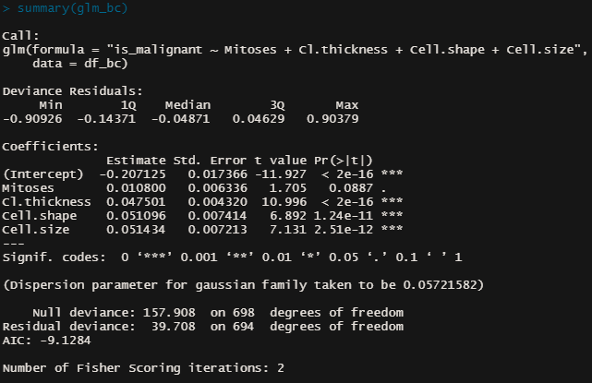
Feature Interpretation
Begin by Baselining:
Given only the intercept (and everything else 0), what’s the probability of being a case?

Slide 65


Feature Interpretation
This is a generalized form of the linear relationship (between feature and target) defined in logistic regression
P is the probability that the sample is a case; the odds ratio indicates how much more likely it is that a sample is case rather than a control

Slide 66
Feature Interpretation
If the odds ratio is 1, what does this mean?
If the odds ratio is less than 1?
If the odds ratio is greater than 1?
P is the probability that the sample is a case; the odds ratio indicates how much more likely it is that a sample is case rather than a control

Slide 67
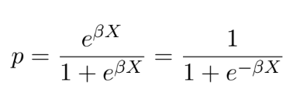
Feature Interpretation
Solving for p gives us:
This expression is just whatever is the result of the linear expression (pre-logistic link function)

Slide 68
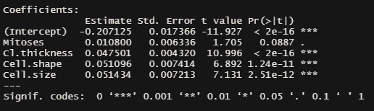
Feature Interpretation
Solving for p gives us:
This expression is just whatever is the result of the linear expression (pre-logistic link function)

Slide 69
Feature Interpretation
Solving for p gives us:
Set all other variables to 0, then the expression will just be the intercept: -0.20
Plugging this in gives us:
p_intercept ~ 0.45
(Consider what this looks like if the intercept is 0)

Slide 70
Feature Interpretation
Solving for p gives us:
Take a look at the expression above.
What happens when the BX portion increases? What happens when it decreases?

Slide 71
Interpreting Clusters

Slide 72
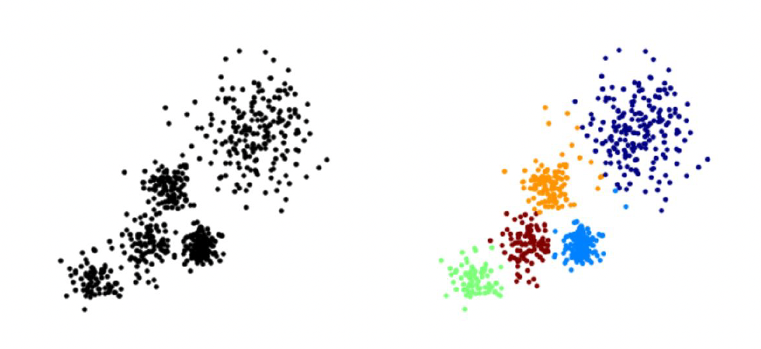
Interpreting Clusters
The overall goal is to divide data into distinct groups such that observations within each group are similar
Here you can see a diagram of unlabelled training data and k means clustering trying to attempt to cluster that data into five distinct clock colored clusters.

Slide 73
Interpreting Clusters
So far, a lot of the interpretation we’ve done has been against some “truth” that we were trying to model (i.e. labels). How about unsupervised algorithms?

Slide 74
Interpreting Clusters
So far, a lot of the interpretation we’ve done has been against some “truth” that we were trying to model (i.e. labels). How about unsupervised algorithms?
“fitting metrics”: distance of centroids, density, elbow-method
Practical Usage

Slide 75
Interpreting Clusters
So far, a lot of the interpretation we’ve done has been against some “truth” that we were trying to model (i.e. labels). How about unsupervised algorithms?
“fitting metrics”: distance of centroids, density, elbow-method
Practical Usage -
Interpretability and actual distinction of clusters (when being described)
Number of clusters (for your use case, is 10 segments practical? Is 20? Is 5?)

Slide 76
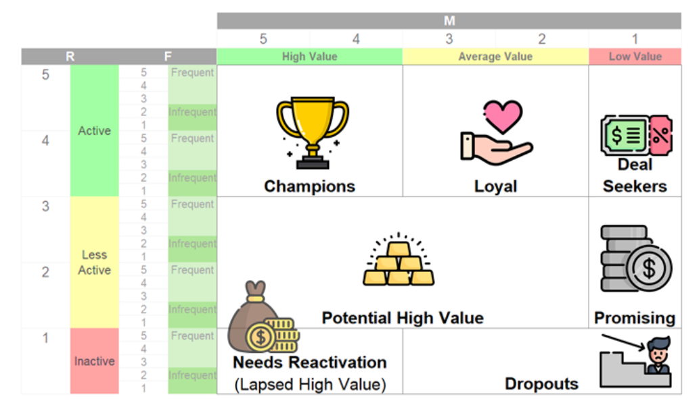
Interpreting Clusters
Other Type of Customer Segmentation RFM
Clustering done via rules/thresholds rather than multidimensional computations are sometimes more practical
(and immediately interpretable)

